Slide 1
Water losses

Slide 2
The hydrologic equation states that
Rainfall – Losses = Runoff
Water Losses
Interception loss – due to surface vegetation, i.e., held by plant leaves.
Evaporation: (a) from water surface, i.e., reservoirs, lakes, ponds, river channels, etc. (b) from soil surface when the groundwater table is very near the soil surface.
Transpiration – from plant leaves.

Slide 3
(4) Evapotranspiration for consumptive use – from irrigated or cropped land.
(5) Infiltration – into the soil at the ground surface.
(6) Watershed leakage – groundwater movement from one basin to another or into the sea.
Interception loss
is defined as the precipitation intercepted by foliage (plant leaves, forests) and buildings are returned to atmosphere (by evaporation from plant leaves) without reaching the ground surface
Effective rain = Rainfall – Interception loss

Slide 4
Evaporation
Evaporation from free water surfaces and soil are of great importance in hydro-meterological studies.
Evaporation from water surfaces (Lake evaporation)
The factors affecting evaporation are
Air and water temperature
Relative humidity
Wind velocity
Surface area (exposed)
Salinity of the water

Slide 5
Evaporation
The rate of evaporation is a function of the difference in vapor pressure at the water surface and in the atmosphere.
The Dalton’s law of evaporation is given by
Constant
Saturated vapor pressure at the temperature of water
Vapor pressure of the air (2 m above ground surface)

Slide 6
Evaporation
The Dalton’s law states that the evaporation is proportional to the difference in vapor pressure $e_{w}$ and $e_{a}.$
A general form of the Dalton’s law is given by

Slide 7
Evaporation
Higher the temperature and wind velocity, greater is the evaporation, while greater the humidity and dissolved solid, smaller is the evaporation.
Methods of Estimating Lake Evaporation
Evaporation from water surface can be determined using the following methods:
(1) The storage equation

Slide 8
Methods of Estimating Lake Evaporation
Auxiliary pans like land pans, floating pans, etc.
Evaporation formula like that of Dalton’s law
Humidity and wind velocity gradients.
The energy budget
The water budget
Combination of aerodynamic and energy balance equations – Penman’s equation

Slide 9
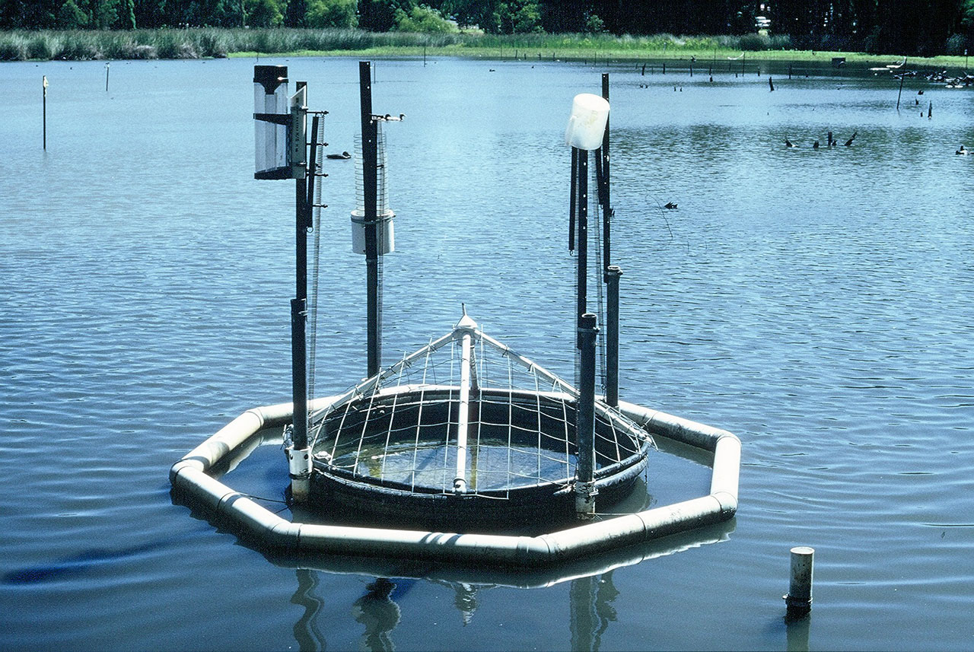
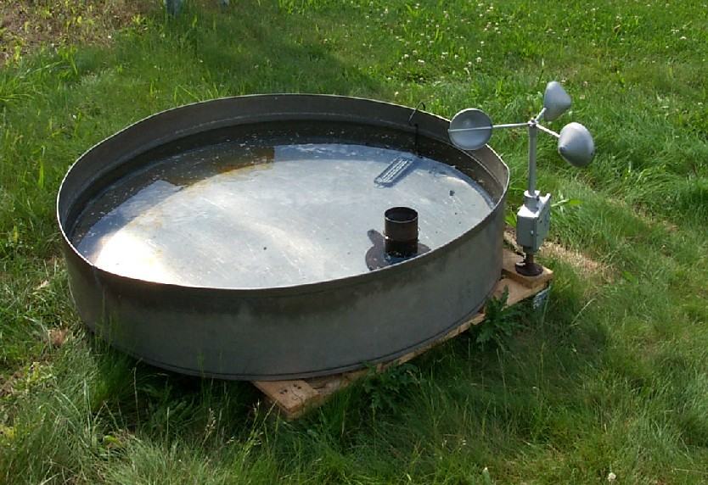
Evaporation Pans
Floating pans
Land pans

Slide 10
Pan Coefficient
Evaporation pan data cannot be applied to free water surface directly but must be adjusted for the differences in physical and climatological factors.
Thus the pan evaporation data have to be corrected to obtain the actual evaporation from surfaces of lakes and reservoirs, i.e., by multiplying by a coefficient called pan coefficient and is defined as
The experimental values for pan coefficients range from 0.67 to 0.82 with an average of 0.7.

Slide 11
Soil Evaporation
The evaporation from a wet soil surface immediately after rain when the water table lies within a meter from the ground is called soil evaporation.
Soil evaporation will continue at a high rate for some time after the cessation of rainfall, then decrease as the ground surface starts drying, until a constant rate is reached which is dependent on the depth of the water table and nature of the soil in addition to meteorological conditions.

Slide 12
Soil Evaporation
Measurement of soil evaporation can be done with tanks (lysimeters) filled with earth and with the surface almost flush with the ground.

Slide 13
Transpiration
Is the process by which the water vapor escapes from the living plant leaves and enters the atmosphere.
Various methods are devised by botanists for measurements of transpiration and one of the widely used methods is by phytometer.
is the total water lost from a cropped (or irrigated) land due to evaporation from the soil and transpiration by the plants or used by the plants in building up of plant tissue.
Evapotranspiration or consumptive use

Slide 14
Evapotranspiration or consumptive use
Potential evapotranspiration (E_{t}) is the evapotranspiration from the short green vegetation when the roots are supplied with unlimited water covering the soil.
Estimation of Evapotranspiration
The following are some of the methods of estimating evapotranspiration
Tanks and lysimeter experiments.
Field experimental plots

Slide 15
Evapotranspiration or consumptive use
Installation of sunken tanks
Evapotranspiration equations as developed by Lowry – Johnson, Penman, Thornthwatie, Blaney – Criddle, etc.
Evaporation index method, i.e., from pan evaporation data as developed by Hargreaves and Christiansen.

Slide 16
Evapotranspiration or consumptive use
Blaney – Criddle method
This method is used throughout the world for the consumptive use determinations and is given by:

Slide 17
Evapotranspiration or consumptive use
where
U = seasonal consumptive use (cm)
t = mean monthly temperature (°C)
p = monthly percentage of hours of bright sunshine (of the year)
k = monthly consumptive use coefficient determined from experimental data
f = monthly consumptive use factor
K, F = seasonal values of consumptive coefficient and factor, respectively.

Slide 18
Evapotranspiration or consumptive use
Example:
Determine the evapotranspiration and irrigation requirement for wheat, if the water application efficiency is 65% and the consumptive use coefficient for the growing season is 0.8 from the following data

Slide 19
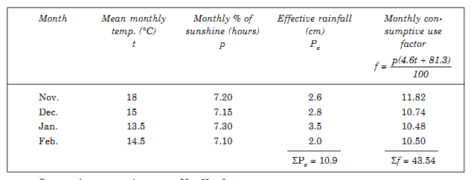
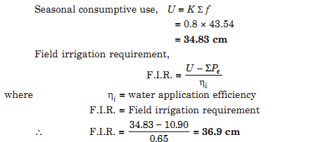
solution:

